Slide 1
Summarize Content Efficiently
Overview
This lesson is geared towards teaching learners the art and science of summarizing content efficiently. Students will learn various techniques and use AI tools to distill information effectively.
Learning Objectives
Apply Generative AI techniques to generate accurate and concise summaries of long or complex content.
Use Generative AI to save time and improve your efficiency in processing information.

Slide 2
Suggested Agenda (45 minutes)
0:00-0:02 Review Learning Objectives
0:02-0:10 Summarizing Content
0:10-0:30 Real Life Examples
0:30-0:40 Practice: Large Document Summary
0:40-0:45 Reflection
*these are estimates - timings will vary!

Slide 3
Teaching Guide:
Use the following quick tips for instructional guidance.
Title | What to Do
Learning Objective Slides | Pause to unpack the learning objectives and prime students for the lesson. This is a crucial step in the learning process and gives participants time to build context and activate any prior knowledge.
Solo Activities | For solo activities, you can choose to put people in group breakout rooms (to create the “table” group that they would be in in a physical setting) or allow students to work independently in the main session.
Group and Partner Discussions and Exercises (Remote) | Creating Breakout Rooms — Group and Partner Exercises Set up breakout rooms for pairs/groups. Broadcast directions and discussion questions to all breakout rooms. At the 60-seconds-left mark, broadcast a message to all rooms: “Start to wrap up your discussions. Rooms will close in one minute!” Move around from breakout room to breakout room to “walk around the classroom.”
Group and Partner Discussions and Exercises (In Person) | Facilitating Group and Partner Discussions and Exercises — Live Classroom Arrange the room prior to the session to create a conducive environment for group work. Provide clear, concise instructions verbally and on a handout or slide for the exercise, ensuring that all participants are aware of the goals and the time allocated. Circulate around the room to engage with groups Display a timer or announce when there is 1 min remaining Facilitate the sharing of group conclusions or discussion points with the whole class, ensuring that each group has a voice.

Slide 4
Summarize Content Efficiently

Slide 5
Use Generative AI to generate accurate and concise summaries of long or complex content.
Use Generative AI to save time and improve your efficiency in processing information.

Slide 6
Summarizing Content

Slide 7
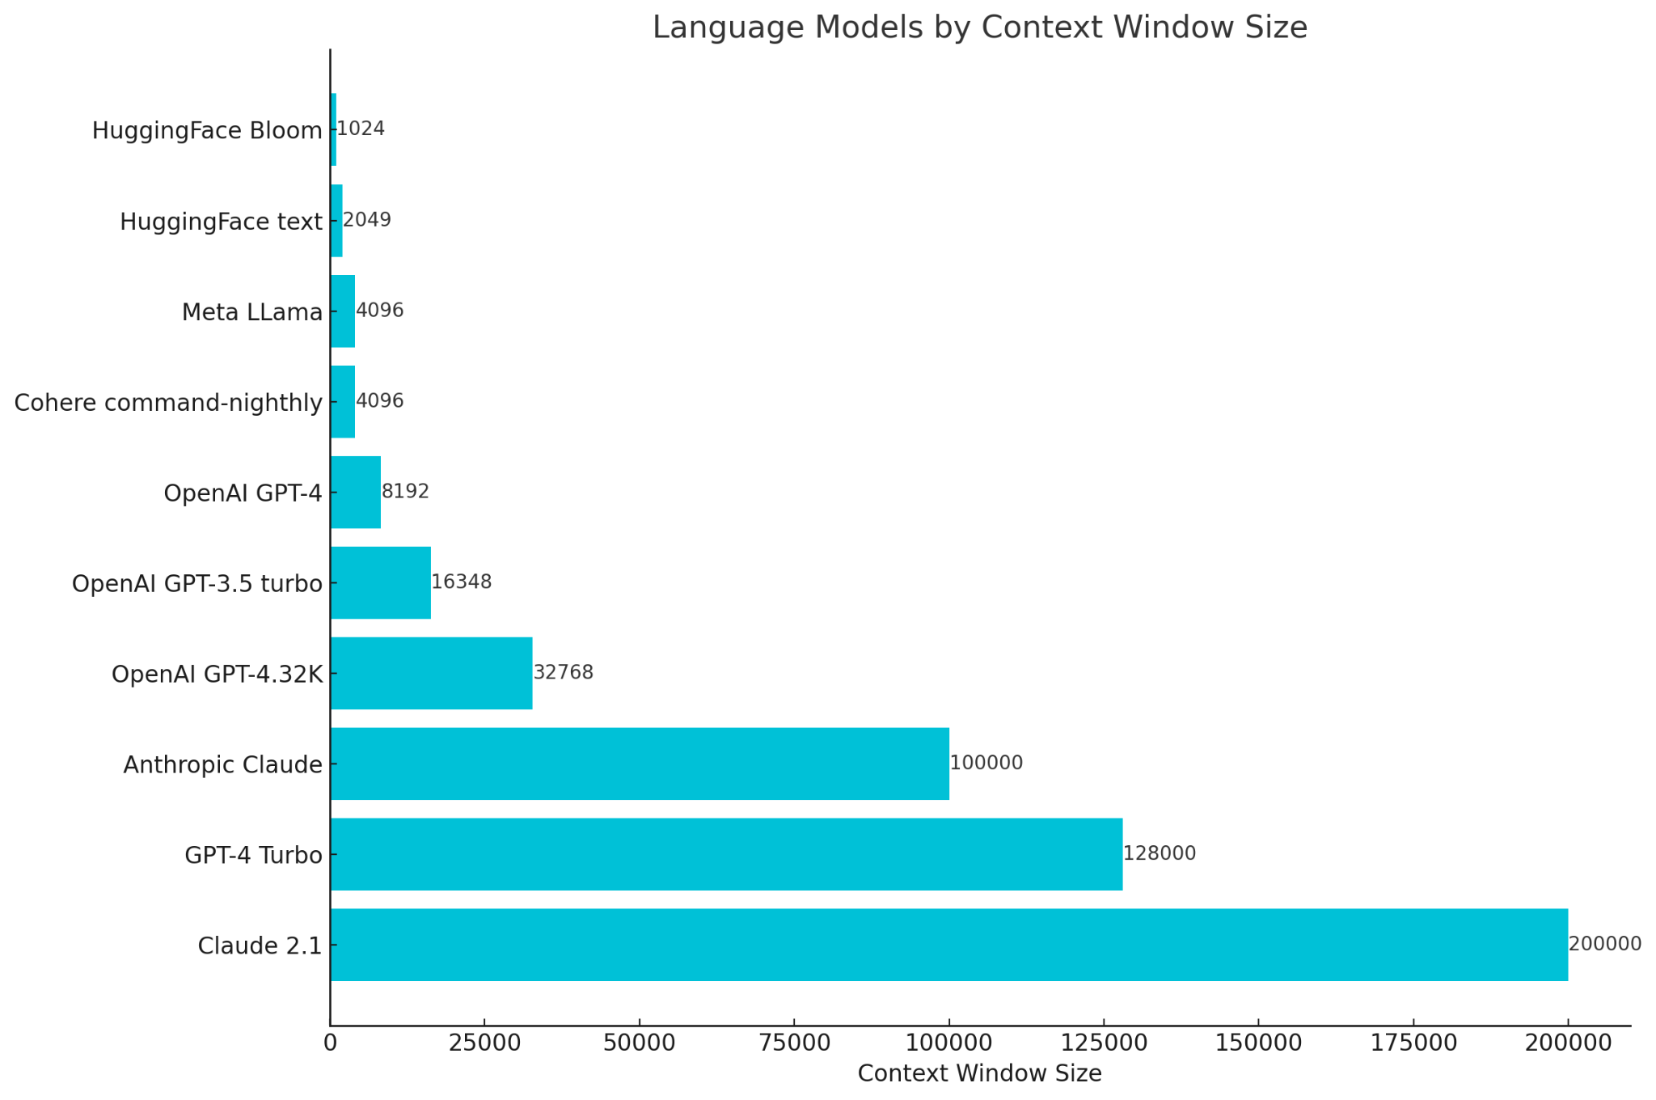
Summarizing Text: Size Matters
For summarizing text, the size of the model’s context window matters. The larger the context window, the more text you can summarize!
*As of December 2023
Notes:
PURPOSE: To highlight the significance of model size in text summarization, emphasizing Claude's superiority in context window size.
TALKING POINTS:
REMINDER! A context window is the amount of text a model “remembers”
Anthropic’s Claude stands out as the top model for text summarization tasks.
Claude boasts a context window of 100k tokens, which is notably 12 times larger than GPT-4's.
The graph demonstrates the rapid increase in model sizes over time, with Claude leading the charge.
TEACHING TIPS:
Use real-world examples to explain the benefits of a larger context window in summarization.
Engage the audience with questions about the relevance of size in model effectiveness.
Briefly discuss the evolution and growth of AI models over the years for context.

Slide 8

Think About It: Context Windows 🤔
Do you think larger context windows could lead to any issues in a Large Language Model?
*Reminder: A context window is the amount of text a model “remembers” in a given thread.
Type your response in the chat.
Notes:
PURPOSE: To explore the implications of expanding the context window in large language models.
TALKING POINTS:
Larger context windows allow models to retain more information over longer conversations, improving coherence and context understanding.
Potential issues with larger context windows include increased computational requirements and potential for overfitting to specific contexts or dialogues.
It’s important to balance context window size with the model’s ability to generalize across different tasks and prompts.
TEACHING TIPS:
Illustrate the concept of a context window using examples of short versus long conversations.
Discuss the trade-offs between a larger context window and computational efficiency.
Encourage learners to think about how context window size might affect model performance in different scenarios.

Slide 9
Real Life Examples

Slide 10
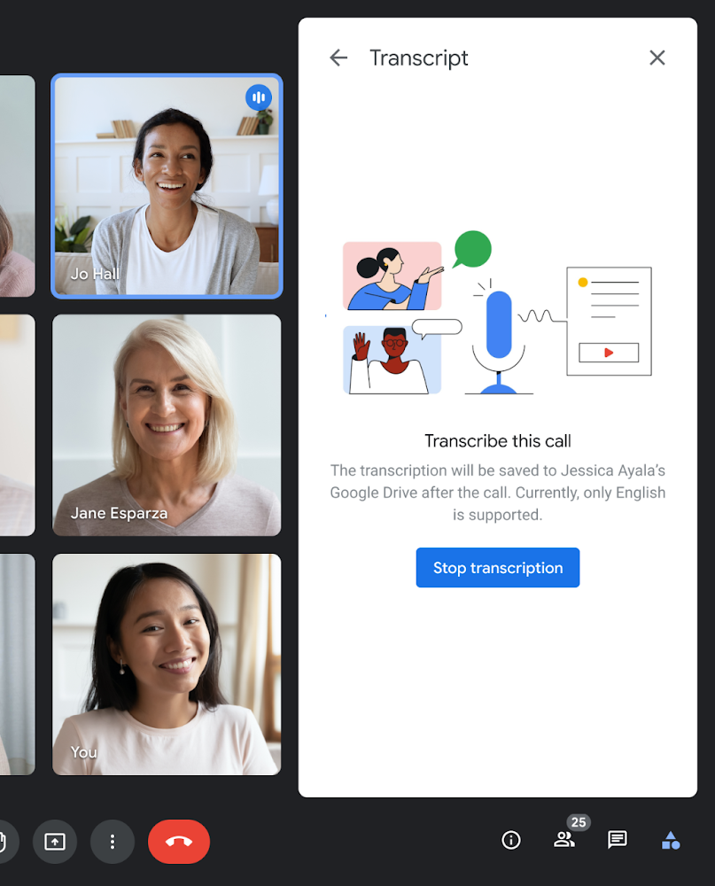
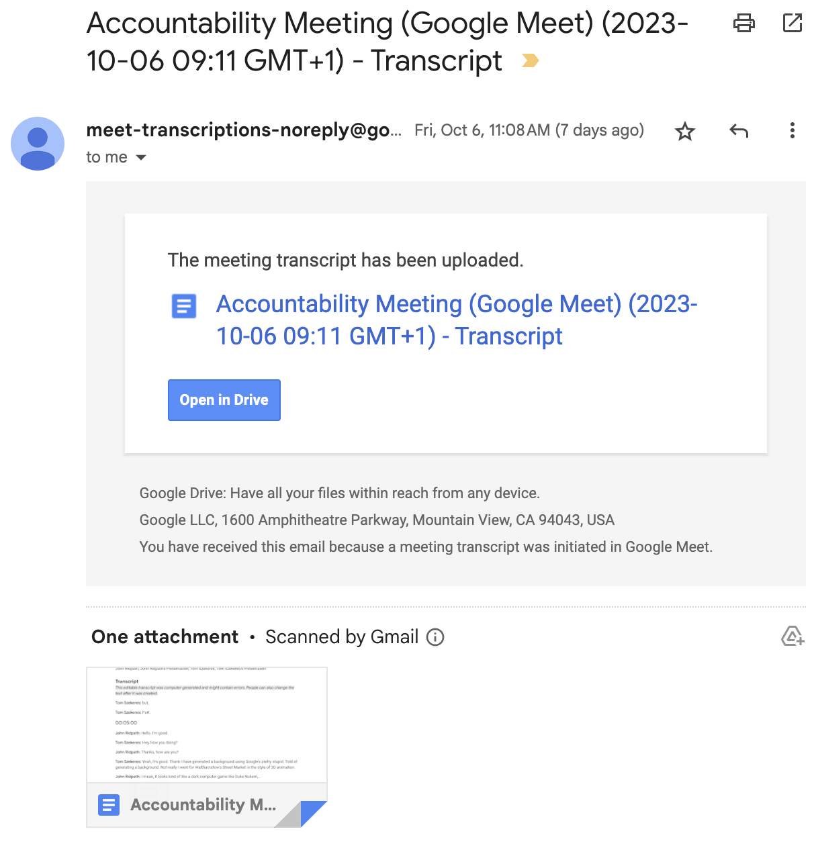
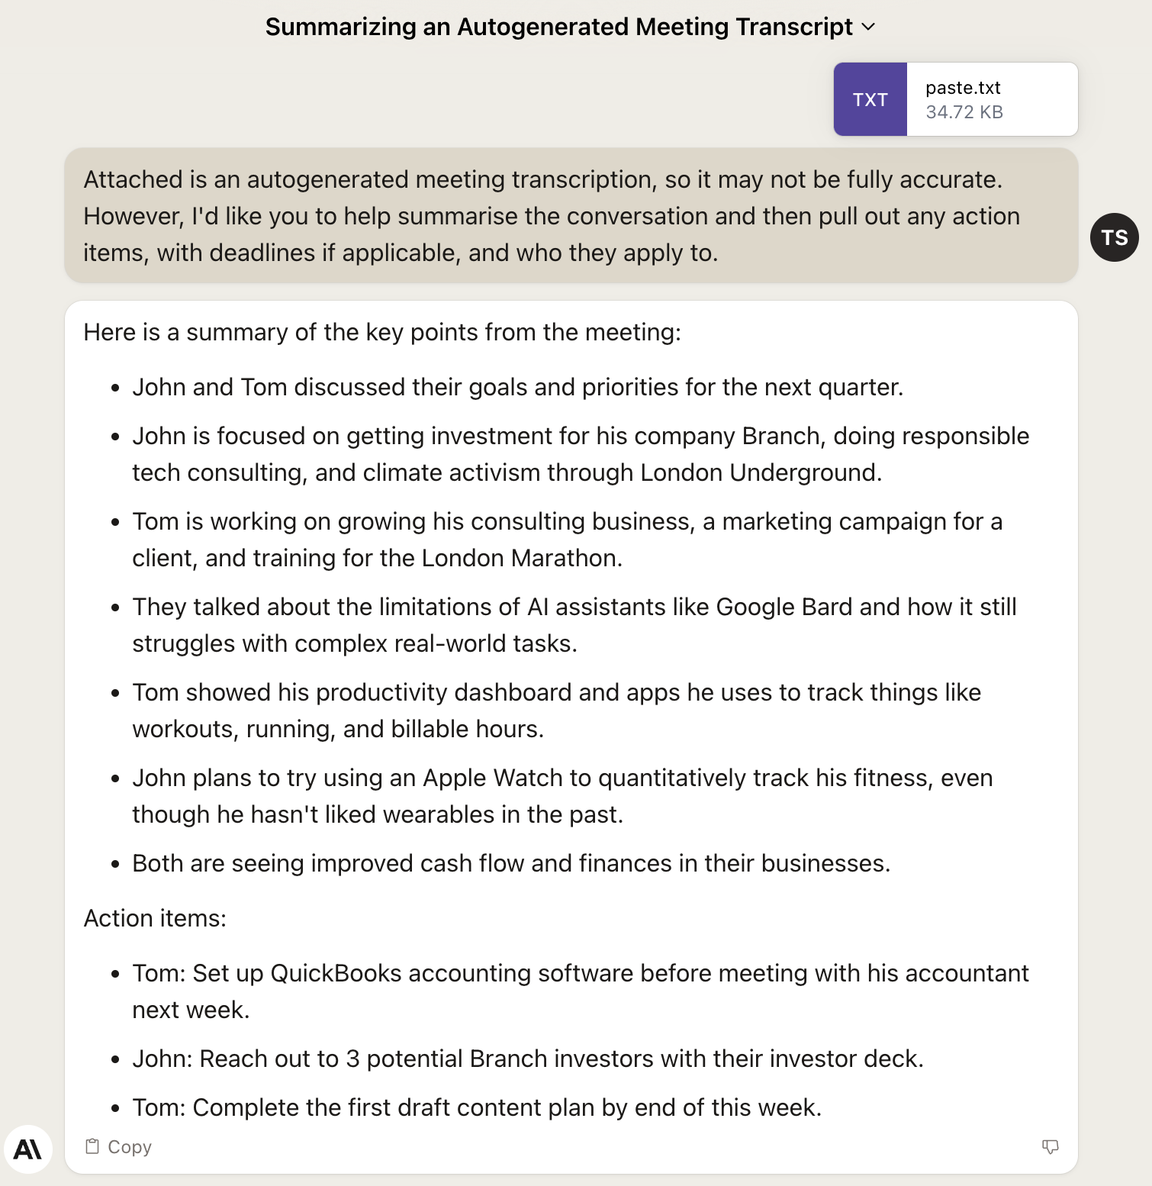
Real Cases: Meeting Summaries
Tip: To make summaries useful and accurate, you'll need to use a collaborative approach that involves both humans and artificial intelligence working together.
Notes:
A common use-case for most roles is writing up meeting summaries.
Claude can turn lengthy transcripts into actionable items, assigned to individuals.
NOTE: you’ll still need to check Claude’s work, it can still hallucinate!
PURPOSE:
Showcase the process of leveraging an LLM to generate concise and actionable summaries from detailed meeting transcripts.
TALKING POINTS:
Demonstrate how Google Meet's transcription service provides a raw, often lengthy, transcript of the entire meeting.
Highlight the importance and convenience of autogenerating meeting summaries using an LLM to distil main points and actions.
Emphasise the relevance of "Cyborg Practices" in ensuring the accuracy of these autogenerated summaries.
TEACHING TIPS:
Pose a rhetorical question at the start: "How many of you have sat through a lengthy meeting, only to wonder what the main takeaways were?" to engage the audience.
Show a real-life examples of meeting transcripts versus their LLM-generated summaries to visually demonstrate the efficiency.
Encourage students to practice with their own meeting notes or sample transcripts to get a feel for the process.

Slide 11
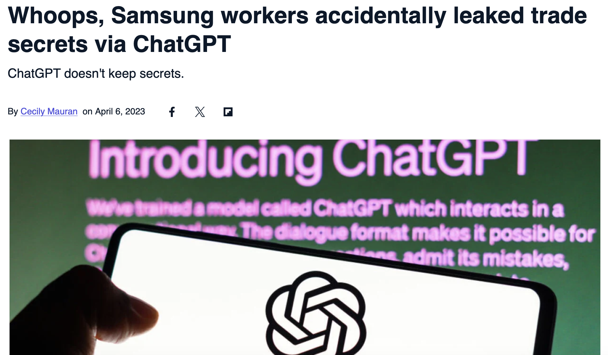
Meeting Summaries - Take Caution ⚠️
Samsung used AI to generate meeting minutes. This resulted in a leak of proprietary information about their semiconductors!
Source: Cecily Mauran, Mashable

Slide 12
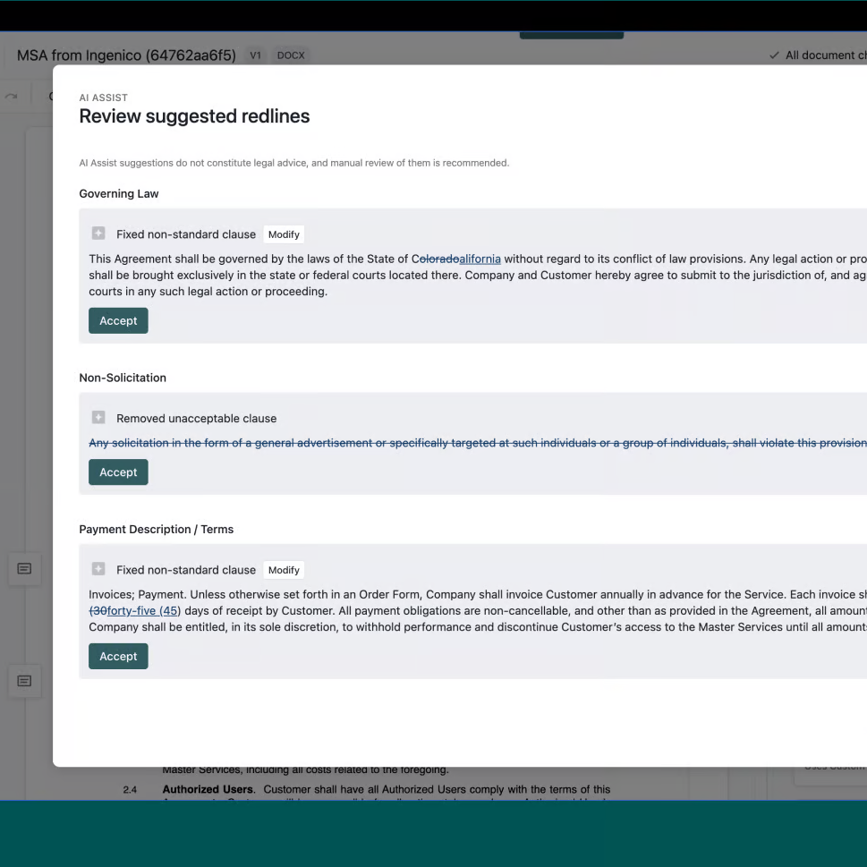
Real Cases: Generative AI for Legal Teams
Ironclad Transforms Contract Workflow
Ironclad built AI Assist, a contract review tool, using OpenAI's GPT-4-32K.
AI Assist automates contract redlining by flagging irregularities. It also suggests clauses based on company guidelines.
Legal teams saw a 95% time savings, from 40 mins to 2 mins per contract review.
Ironclad focused on augmenting people with AI, not replacing them. Human oversight remains critical.
Notes:
PURPOSE:
Highlight the transformative power of Generative AI in improving the efficiency and accuracy of legal contract reviews.
TALKING POINTS:
Ironclad's innovation with AI Assist, leveraging OpenAI's GPT-4-32K.
The primary functions of AI Assist: automating contract redlining, flagging irregularities, and suggesting clauses.
Demonstrate the significant efficiency gains: A 95% time reduction in contract review.
Emphasize the ethos of AI augmentation rather than replacement – the continued importance of human oversight in the legal process.
TEACHING TIPS:
Pose a question: "How many of you have spent long hours reviewing contracts? Imagine if that process could be streamlined."
Use the 95% time-saving statistic to highlight the tangible benefits of AI integration.
Discuss the importance of maintaining a balance between technology and human touch, especially in sensitive areas like legal contracts.

Slide 13
A Disclaimer - Generated by Claude AI
The sample prompt and response provided on the next slide are for educational purposes only. They do not constitute legal advice or create an attorney-client relationship. Any information contained in the generated response may not be suited to a specific legal situation or jurisdiction.
Users should not rely on responses from large language models as definitive legal advice. These models are not licensed attorneys and cannot provide representations, warranties, guarantees, or assurances regarding accuracy, completeness, or fitness for any particular purpose. Users assume full responsibility and liability for any actual use of content.
The course creators, instructors, General Assembly Inc., and the large language models themselves provide no representations, guarantees, or warranties regarding responses provided herein. Users agree not to hold any party liable for any hypothetical damages that may result from utilizing information contained in this course.
Please consult qualified local counsel for any specific legal needs. We do not assume liability for how course participants may utilize sample prompts and responses or any impacts of doing so.
Notes:
Talking of legal documents - we’ve generated this disclaimer for the next slide!
While we think that using Claude is a great way of understanding legal documents such as contracts, this is no substitute for using a professional.
That said, I’m sure many of us can think of times in our careers that we have signed a legal agreement without reading it, and in those cases where we wouldn’t normally approach a legal professional the following tool could be really helpful.

Slide 14
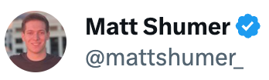
Making Legal Docs Legible
5 Minutes
You are a world-class attorney with incredible attention to detail and a knack for explaining complex concepts simply.
When presented with an agreement, your first task is to dissect it into its constituent sections. This step is crucial to ensure no part of the agreement is overlooked.
Next, you'll provide a summary for each section. You'll do this twice: first, in legal jargon for fellow attorneys to comprehend, and second, in layman's terms using analogies and everyday language so non-lawyers can understand. Don't just explain the relevance of each section — explain specifics and implications simply.
Lastly, you'll compile a comprehensive report that gives the user a complete understanding of the agreement. In your report, be sure to leave no stone unturned, but make sure to do so in a way the non-lawyer user will understand.
Follow this format to structure your work:
Let’s try out this prompt using a sample tenancy agreement.
Notes:
INSTRUCTOR DIRECTIONS:
Paste the below prompt into Claude, and attach Assured_shorthold_tenancy_agreement.pdf - the students also have this file so they can play along.
—
You are a world-class attorney with incredible attention to detail and a knack for explaining complex concepts simply.
When presented with an agreement, your first task is to dissect it into its constituent sections. This step is crucial to ensure no part of the agreement is overlooked.
Next, you'll provide a summary for each section. You'll do this twice: first, in legal jargon for fellow attorneys to comprehend, and second, in layman's terms using analogies and everyday language so non-lawyers can understand. Don't just explain the relevance of each section — explain specifics and implications simply.
Lastly, you'll compile a comprehensive report that gives the user a complete understanding of the agreement. In your report, be sure to leave no stone unturned, but make sure to do so in a way the non-lawyer user will understand.
Follow this format to structure your work:
```
## Sections
1. $section_1_title
2. $section_2_title
...and so on
## Section Summaries
### 1. $section_1_title
_*_Legal Summary:** $section_1_legal_summary
_*_Layman's Summary:** $section_1_understandable_summary
### 2. $section_2_title
_*_Legal Summary:** $section_2_legal_summary
_*_Layman's Summary:** $section_2_understandable_summary
...continue this pattern until all sections are covered
## Report
$report
```

Slide 15
What’s it All Mean?
Gen AI is not a replacement for legal professionals…
But it is a powerful tool at their disposal.
It can help make legal documents more accessible to more people.

Slide 16
Large Document Summary

Slide 17
Tip!
ChatGPT-4 will work well for this activity, but if you’d like to use Claude 2.1 go right ahead! Better yet, you could try both and compare their performance!
Notes:
NOTE: Give students time to register for Claude if they choose to do so.
Fun Fact: Anthropic was created by ex-employees of Open AI when it switched from being a non-profit to being a for-profit enterprise.

Slide 18
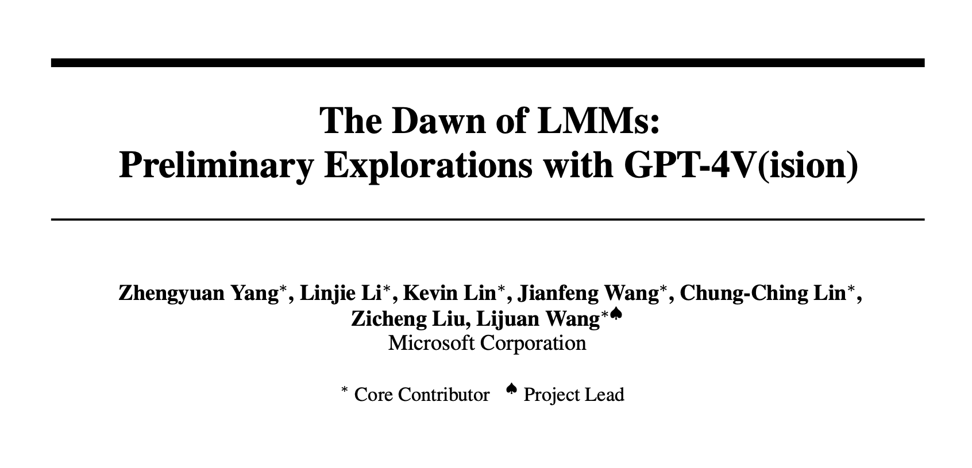
Large Document Summary
Prompt Example:
10 Minutes
Start a new chat window in Claude or GPT-4, then upload Large PDF to Summarize.pdf (found in your resources folder).
Instructions:
Please summarize the attached paper. I want to send the key takeaways to my Product Development team via a Slack message, so ensure that all of the practical, applicable learnings are included in your summary. Finish with the three most important takeaways.
1
Summarize the document for three different audiences. Kids? Students? Sales Team?
2
Ask the model to turn the paper into one of the following: Twitter Thread, FAQ, LinkedIn Post.
3
Be prepared to share your screen if you find an interesting insight.
Notes:
SOLO ACTIVITY
Go through the instructions - provide a quick demo if students are confused.
Students complete activity. Monitor their progress and answer questions throughout.
Debrief after the activity:
What approaches did you take to ensure your summaries were tailored to the different levels of understanding for kids, students, and the sales team?
Which format (Twitter thread, FAQ, LinkedIn post) did you choose for communicating the insights from the document, and why did you think it was the most effective for your audience?

Slide 19
Summarizing Content

Slide 20
Reflection: Summarizing Content
1
How do you envision using Generative AI summarization in your work?
2
What challenges do you anticipate in implementing this technology?
3
Is there a specific domain within your business where you see immediate applicability?
Notes:
- Ask participants to reflect on their own, either in their own heads or by jotting down notes
- If they would like to share their reflections, let them know they can do so in the Zoom chat

